Slide 8
Principles of Computer System Design ♥ Saltzer & Kaashoek 2009

Slide 9
Principles of Computer System Design ♥ Saltzer & Kaashoek 2009

Slide 10
Principles of Computer System Design ♥ Saltzer & Kaashoek 2009

Slide 11
Principles of Computer System Design ♥ Saltzer & Kaashoek 2009

Slide 12
Principles of Computer System Design ♥ Saltzer & Kaashoek 2009

Slide 13
Principles of Computer System Design ♥ Saltzer & Kaashoek 2009

Slide 14
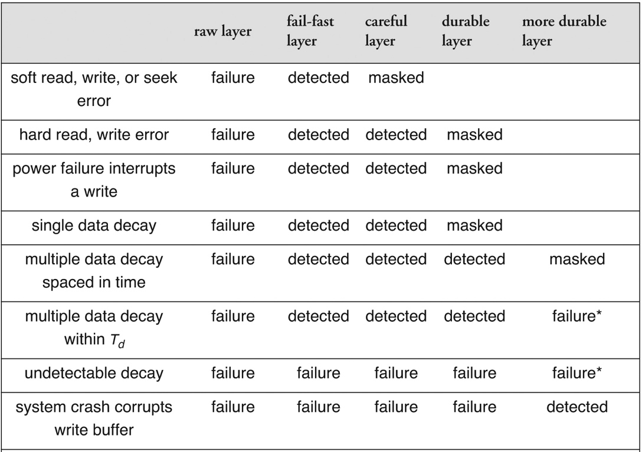
Principles of Computer System Design ♥ Saltzer & Kaashoek 2009

